Slide 1
Toolbox
Jocelyn and mesawit

Slide 2
Team norm
Meet in class
Meet outside class
No negativity
Listen to others idea
No idea is stupid
Communication
Communicate Facebook, mail , kik others………

Slide 3
Problem statement/ constrain
The Candy Company is celebrating its 50th year anniversary and would like to provide consumers with a candy dispenser that will house the four existing bite-size candies that they currently produce. They also want new shapes created for each candy.
Constraints: | Must be durable. Must fit into a box with interior dimensions of 8 in. wide x 4 in. deep x 4 in. high. Must be an assembly of a minimum of four different parts. Must hold the four new candy shapes. The new candy shapes cannot exceed ½ in. width, depth, height, or diameter.

Slide 4
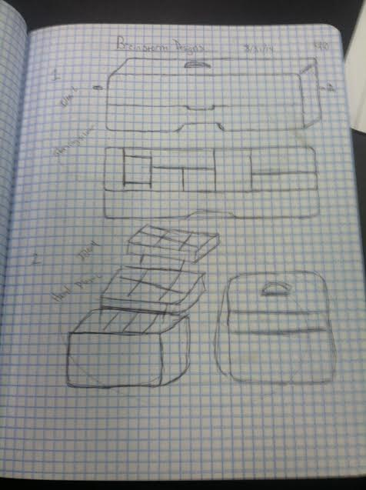
Brainstorming sketchs

Slide 5
Design matrix

Slide 6
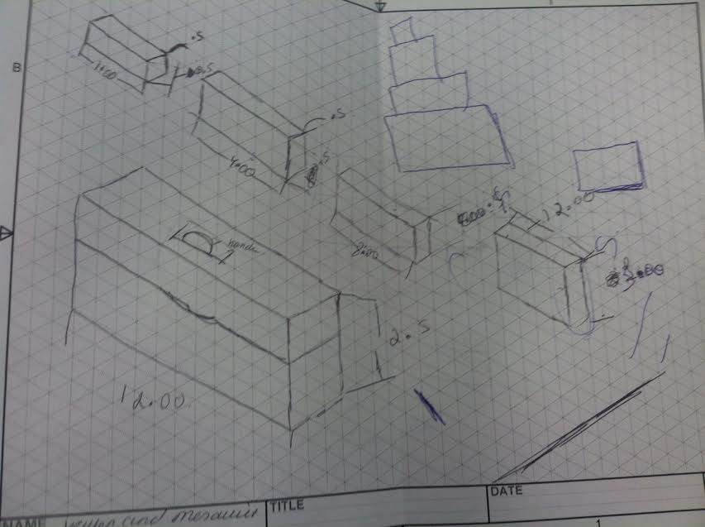
Detailed scetch

Slide 7
Screen shots of the parts

Slide 13
Screen shots of drawing file

